Slide 1







$$I$$
$$𝓁_{r}$$
$$I_{o}$$
$$𝓁_{s}$$
$$γ_{r}$$
$$γ_{s}$$
$$σ 𝒜$$
Scattering Patch

Slide 2



$$τ_{c}$$
$$τ_{a}$$
$$τ_{b}$$

Slide 3





sum across
patches
$${I(t}_{c})$$
intensity
$$T$$
$$t_{a}$$
$$t_{b}$$
$$t_{c}$$
two way travel time

Slide 4





$$𝒜_{sr}(t+T,T,φ,Δφ)$$
$$𝒜_{sr}(t,T,φ,Δφ)$$
$t−T$isochron
$t+T$isochron
$t$isochron

Slide 5

incident
Gaussian
beam
w_{ϕ}
w_{η}
γ
γ
L
W
projection onto interface

Slide 6
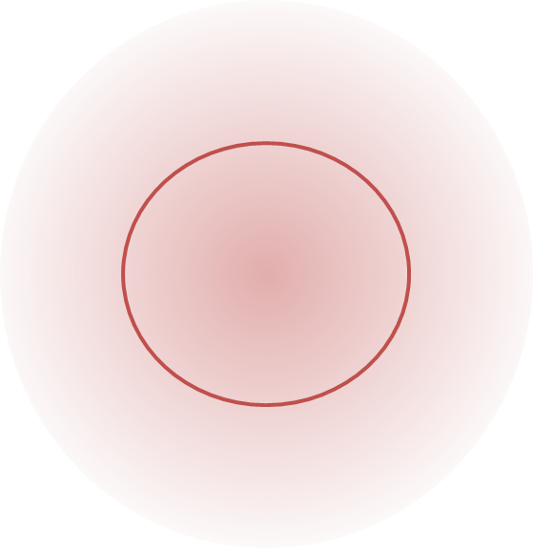

I_{s}
$$δr$$
I_{r}
I₀
I

